Slide 1

Symbolic AI
COMP 4230
David J Stucki
Fall 2024

Slide 2
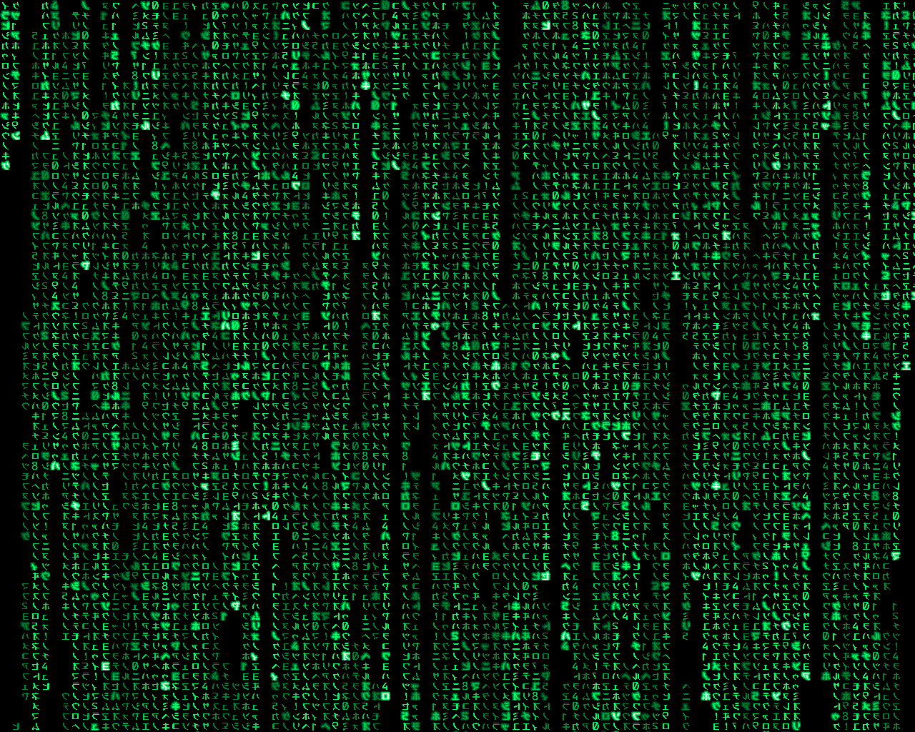
Alerts
Assignment #2, due Friday, 9/13
Read Larson, chapters 5 & 6
Read Haugeland, "What is Mind Design?"

Slide 3
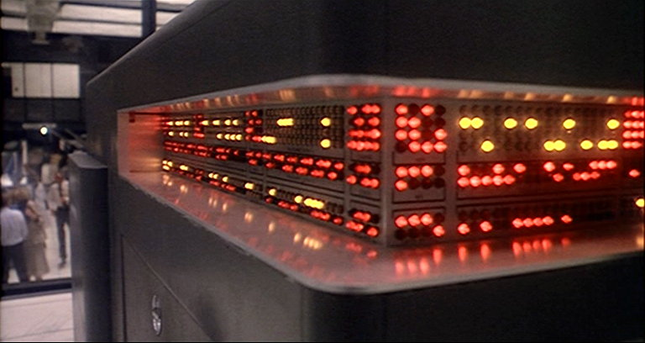
Automatic Formal Systems*
A computer is an Automatic Formal System
A Formal System is like a game in which tokens are manipulated according to definite rules, in order to see what configurations can be obtained. In other words, they are:
  Token-manipulation systems
  Digital
  Medium Independent
Not all formal systems are games and not all games are formal systems
*John Haugeland, “What is Mind Design?”, in Mind Design II, MIT press, 1997, pp. 8-15.

Slide 4
Automatic Formal Systems*
A Token-Manipulation System has the following components
  a set of types of formal tokens or pieces (symbols)
  one or more allowable starting positions
  a set of formal rules specifying how arrangements of tokens may or must be changed into others
A TMS must be self-contained
Rules must have a 'local' perspective
current → next
*John Haugeland, “What is Mind Design?”, in Mind Design II, MIT press, 1997, pp. 8-15.

Slide 5
Automatic Formal Systems*
Digital Systems
  A process that makes things and then later identifies what was made is digital as long as it is positive and reliable
  It is positive if the re-identification can be absolutely perfect
  A positive technique is reliable if it not only can be perfect, but almost always is
    chess, tic-tac-toe, go, checkers
    vs.
    baseball, billiards, tiddly-winks, marbles
*John Haugeland, “What is Mind Design?”, in Mind Design II, MIT press, 1997, pp. 8-15.

Slide 6
Automatic Formal Systems*
Medium Independence
  Form, or structure, is what defines a formal system
  Its substance, or material, is irrelevant insofar as it supports the requisite form
  Chess
    Can be played with pieces of wood, plastic, ivory, patterns of light on a video monitor, sand-drawings, even helicopters on skyscrapers
    But not frogs, shapes traced in water, or mountains
  Fire, food, electrical circuits, and baseball are all not independent of substance
*John Haugeland, “What is Mind Design?”, in Mind Design II, MIT press, 1997, pp. 8-15.

Slide 7
Automatic Formal Systems*
A formal system than 'moves' by itself is an Automatic Formal System
A physical device or machine that
  has configurations and states which can be regarded as tokens and arrangements of some formal system ,and
  in its normal operation it automatically manipulates these tokens in accord with the rules of that system
a.k.a., a computer!
*John Haugeland, “What is Mind Design?”, in Mind Design II, MIT press, 1997, pp. 8-15.

Slide 8
Implementation and Universality
The most basic idea of computer science:
  'You can use one automatic formal system to implement another'
  Really, this is why we believe the Church-Turing Thesis
This is what programming is!!
One computer implements another when
  some configuration of tokens and positions of the former can be regarded as the tokens and positions of the latter, and
  as the former follows its own rules, it automatically manipulates those tokens of the latter in accord with the latter's rules
*John Haugeland, “What is Mind Design?”, in Mind Design II, MIT press, 1997, pp. 8-15.

Slide 9

The Physical Symbol System Hypothesis
A Physical Symbol System consists of symbols representing discrete concepts which are combinable into expressions. There are processes which operate on or manipulate these symbols to create new symbols and expressions.
The PSS Hypothesis states that a PSS has the necessary and sufficient means for intelligent action
[Herbert Simon, Allan Newell (CMU, 1970s)]
Basically the 'Thinking is Computing' claim dressed up in different clothes, since a PSS is really just an automatic formal system

Slide 10

Symbolic Approaches
Search
  Playing games: searching the game tree of future moves
  Optimization problems: search space for global optimum
  Planning: search space for feasible courses of action to achieve goal
  Learning: search for rules that account for positive examples, but not negative ones
Knowledge Representation
  first-order logic & inference engines
  capture laws or rules for decision making
  expert systems

Slide 11
Expert Systems
Medical Diagnosis
  Rules for mapping symptoms to diseases, based on doctor's expertise
  Example: MYCIN, a backchaining system that identified bacteria causing infections, recommended antibiotics & dosages (Shortliffe, 1970s)
Science & Engineering
  DENDRAL: rules for interpreting chemical structures from mass-spectrometry data (Feigenbaum, 1960s)
  PROSPECTOR: used geological data to identify probable oil fields (1970s)
  Mistral: monitors and diagnoses dam safety (1990s)
Design
  R1: Produced optimal configurations of computer equipment (McDermott, 1978)

Slide 12
So how does it work...?
Knowledge may be represented as symbol structures (essentially, complex data structures) representing bits of knowledge (objects, concepts, facts, rules, strategies..).
  E.g., 'red' represents color red.
  'car1' represents my car.
  red(car1) represents fact that my car is red.
A KR language should allow you to:
  represent adequately the knowledge you need for your problem
  do it in a clear, precise and “natural” way.
  allow you to reason on that knowledge, drawing new conclusions

Slide 13
Representational adequacy
Consider the following facts:
  John believes no-one likes brussel sprouts.
  Most children believe in Santa.
  John will have to finish his assignment before he can start working on his project.
Each can be represented as a string! But it is hard then to manipulate and draw conclusions.
Some notations/languages only allow representation of certain things.
Time, beliefs, uncertainty, all hard to represent

Slide 14
How knowledge representations are used
Questions,
requests
Answers,
analyses
Examples,
Statements
Inference
Mechanism(s)
Learning
Mechanism(s)
Knowledge
Base

Slide 15
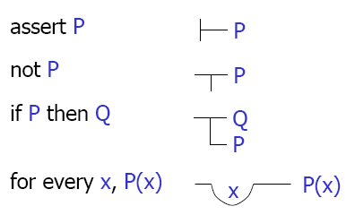
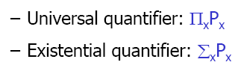
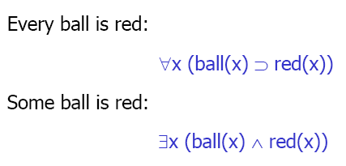
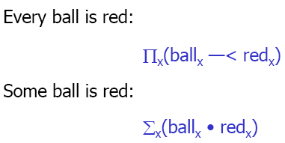
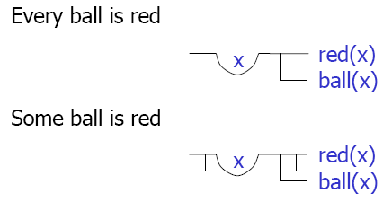
Logic Notations
Frege's Begriffsschrift
(concept writing), 1879
Peirce's Algebraic Notation, 1883
Peano's Notation, 1889

Slide 16
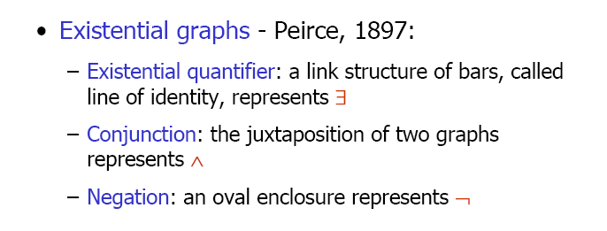
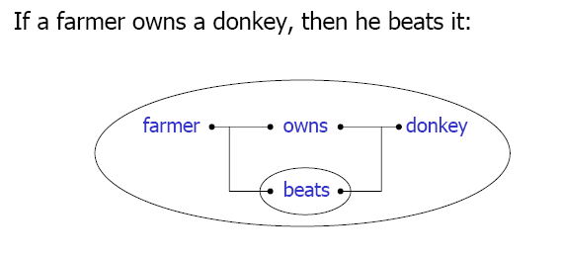
Logic Notations

Slide 17
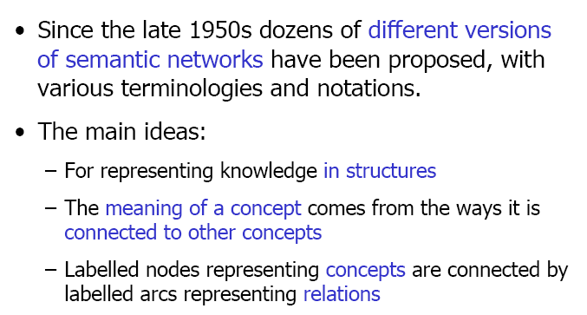
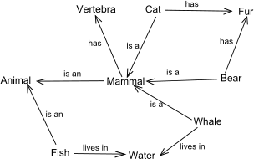
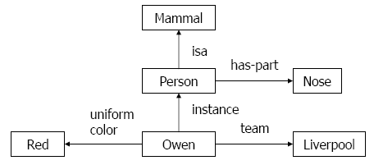
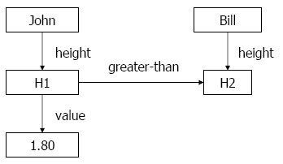
Semantic Networks

Slide 18
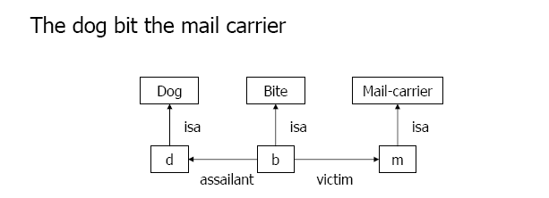
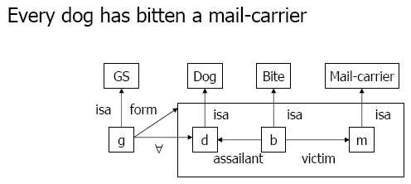
Semantic Network Examples

Slide 19
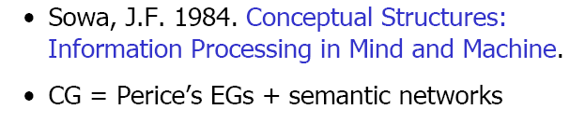
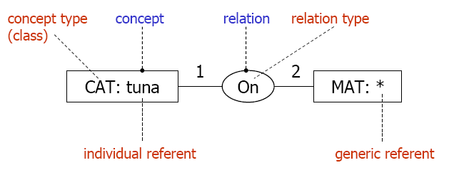
Conceptual Graphs
Based on the one hand in linguistics, psychology and philosophy, and data structures and data processing techniques on the other. (Bogdan L. Vrusias)

Slide 20
Conceptual Graph Example
"John is between a rock and a hard place"
rock
person: John
between
place
attribute
hard

Slide 21
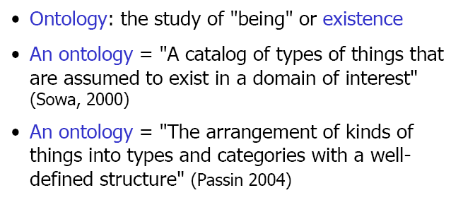
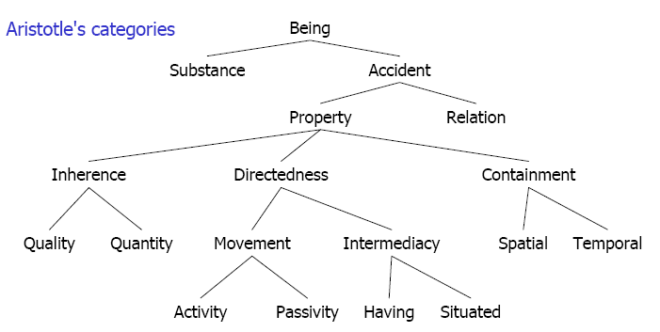
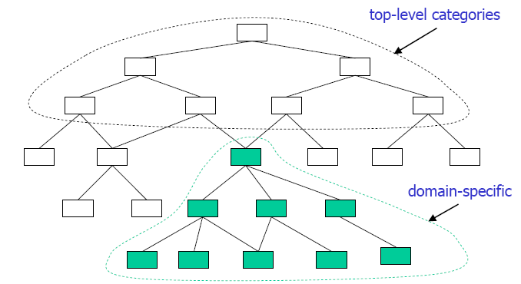
Ontology
Knowledge engineering is the application of logic and ontology to the task of building computable models of some domain for some purpose.
– John Sowa

Slide 22
Nested Concepts
"Tom believes that Mary wants to marry a sailor"
person: "Tom"
EXPR
believe
PTNT
proposition
person: "Mary"
EXPR
want
PTNT
situation
"Mary"
AGNT
marry
PTNT
Sailor
: co-reference link

Slide 23
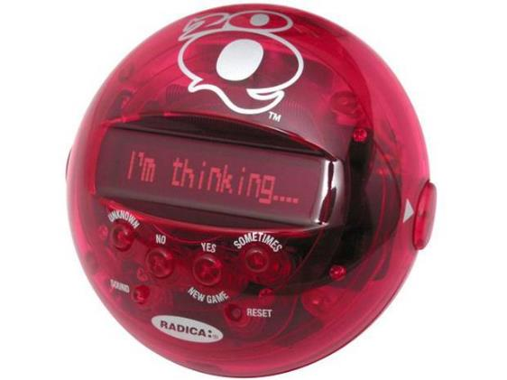
Questions?

